Slide 1
operating system 2
Documentation

Slide 2
producer process while (buffer not = isFull) { ... /* produce an item in next_produced */ ... Empty acquire Mutex acquire ... /* add next produced to the buffer */ ... Mutex release Full release }
pseudocode

Slide 3
consumer process while (buffer not Empty) { acquire (full); acquire (mutex); ... /* remove an item from buffer to next_consumed */ ... release (mutex); release (empty); ... /* consume the item in next consumed */ ... }
pseudocode

Slide 4
A deadlock occurs when two or more processes all block one another from completing execution.
Deadlock

Slide 5
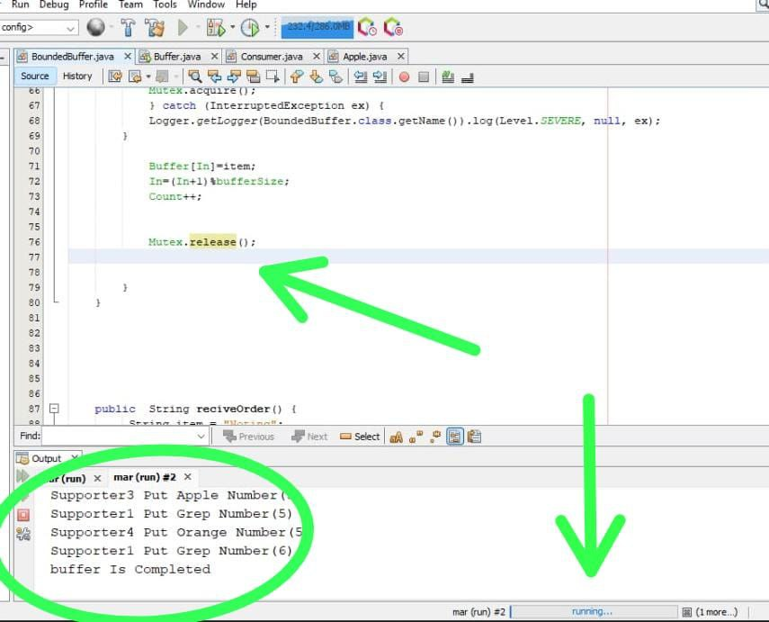
Example of a deadlock
is a program with two Produce and two mutexes, where each Produce needs access to both mutexes but does not release it's own mutex until it acquires the other mutex. An example:
Producer 1 locks Mutex 1
Producer 2 locks Mutex 2
Producer 1 wants to lock Mutex 2 but has already been locked by Producer 2!
Producer 2 wants to lock Mutex 1 but has already been locked by Producer 1!

Slide 6
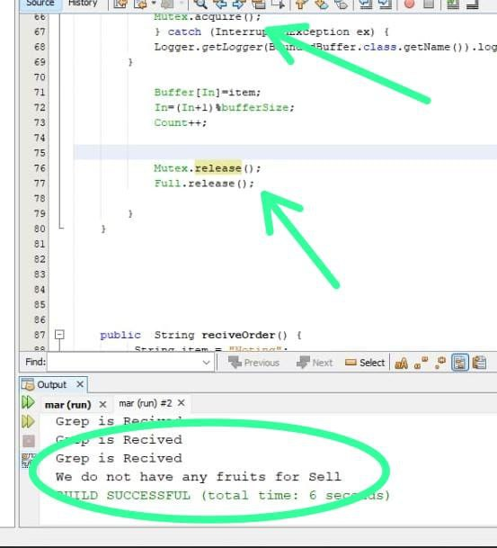
When I put the (full.release) in code
Solution

Slide 7
Definition Of Starvation:
Starvation of thread in java is said to occur when a particular thread does not get access to the object or the resource which leads to an increase in waiting and execution time.
Starvation is said to occur when two or more threads are allocated to the C.P.U. (Central Processing Unit) and takes a lot of time in execution, due to which other waiting threads cannot get the C.P.U. for its execution to carry on.

Slide 8
Starvation on Producer and Consumer Project:
This kind of "waiting while holding buffer" scenario can lead to starvation
Consumer on certain condition is not returning the previously consumed buffer to empty buffer queue and continuing to wait for next ready buffer ready to be consumed.
Or Producer on certain condition is not returning produced buffer to ready buffer queue and continuing to wait for empty buffer to produce.
Then eventually this kind of situation will lead to starvation.

Slide 9
Causes Of Starvation:
There are many reasons for causes of starvation of threads in java, some of them are described below:
High Priority Running Thread: There may be a case where a high priority thread is running by occupying the C.P.U. and it needs heavy processing which requires a lot of time in completion, so for this work to get completely executed the other threads which have a low priority order have to wait for a long time which leads to starvation.
Synchronized Block In Java: There may be a case where the order in which the threads are allowed to enter the synchronized block is granted the resources in the same order as they are programmed to be scheduled, which results in waiting for the resources and the objects by another thread leading to starvation, where the other threads other than a particular thread are given the C.P.U. for its execution.
Threads Waiting On An Object Remains Waiting Forever: The notify() method in java has no track on the threads that which particular thread is wakening if there are multiple threads, therefore there may be a risk that any of the thread is being processed and the other threads are never called for execution.

Slide 10
Example Of Starvation:
-Starvation occurs in Priority Scheduling or Shortest Job First Scheduling. In the Priority scheduling technique, we assign some priority to every process we have, and based on that priority, the CPU will be allocated, and the process will be executed. Here, the CPU will be allocated to the process that has the highest priority. Even if the burst time is low, the CPU will be allocated to the highest priority process
- Suppose an object provides a synchronized method that often takes a long time to return. If one thread invokes this method frequently, other threads that also need frequent synchronized access to the same object will often be blocked
- When two threads are having different priority then the thread having higher priority will get the first chance to execute. Low priority thread has to wait until completing all high priority threads. It may have to wait for a long time period for its execution but waiting will end at a certain point. This situation is an example of

Slide 11
Some of the important points to remove starvation of threads are given as follows:
By implementation of the Thread.yield() method, so that when the thread in the process after releasing the lock gets a fair chance to occupy the C.P.U. and can get some time to complete its execution till the original thread again gets the control over the C.P.U.
One can also use the Thread.sleep() method to given chance to other Threads for execution.
An independent manager can be used for allocation of resources. This resource manager distributes resources fairly and tries to avoid starvation.
Random selection of processes for resource allocation or processor allocation should be avoided as they encourage starvation.
The priority scheme of resource allocation should include concepts such as aging, where the priority of a process is increased the longer it waits. This avoids starvation.

Slide 12
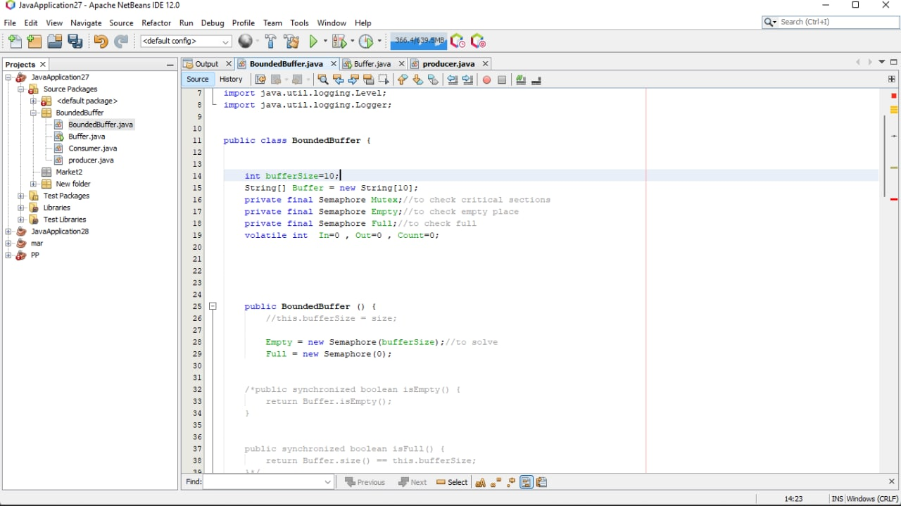
We can solve starvation on our real world by making priority queue
Starvation occurs when we use this lines :

Slide 13
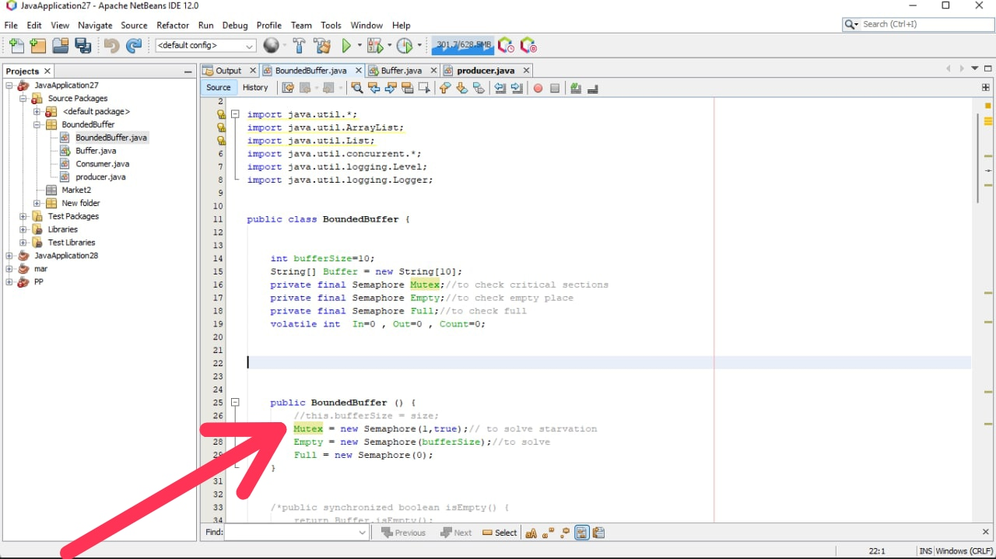
Starvation will be solved by the following lines of code:

Slide 14
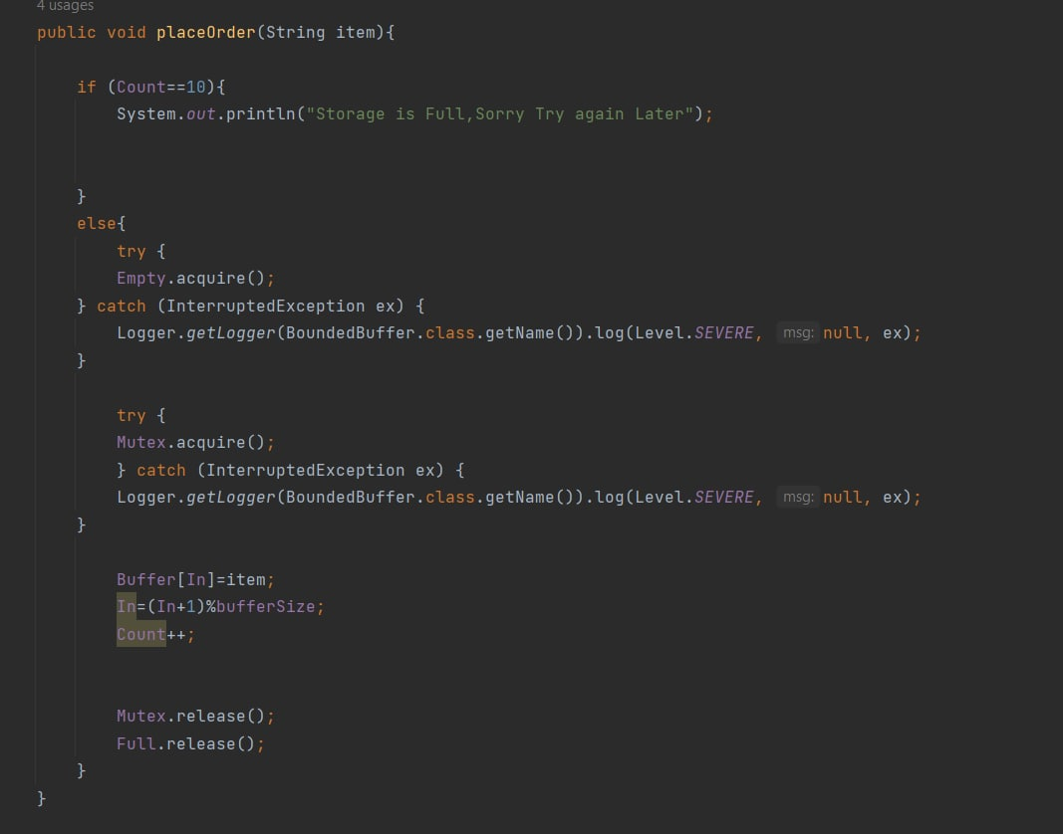

Slide 15
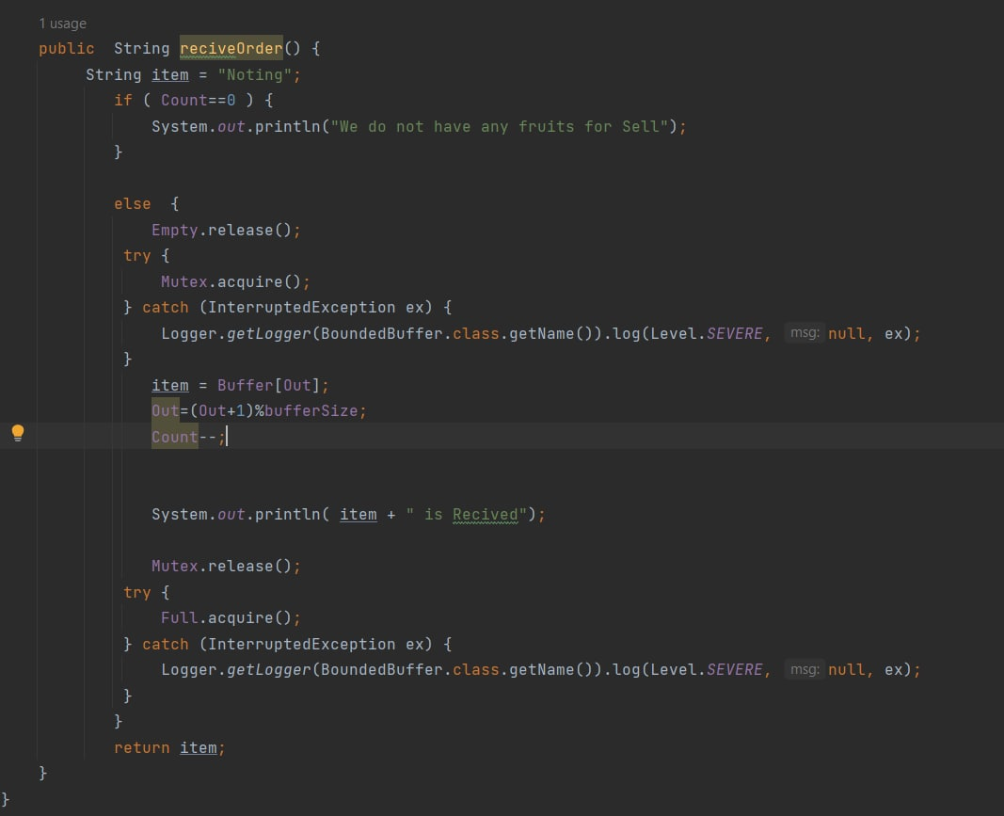

Slide 16
*First of All: The real world Application is “Fruit’s requests of Market “in the title of : "Fruit Market " To our real world .. Assume: we have lots types of fruits in our market and we have (n) of people who wanna request the type which they need in our market so the number of our fruits is less than the people So it will be no fruit for a time till producing another amount to fulfill the request and orders, SO in the following we will describe how we will Apply this problem..
• Explanation for real world application and how did apply the problem:

Slide 17
* Finally:
“How to apply the problem”..
We will implement “semaphore “which is contains of: wait () and Signal () which prevent a “deadlock” problem or by using ‘’Reentrant lock ‘’and we will implement “priority Queue “to solve the problem of “starvation” with wakeup() , block () ,acquire () and release () or by using ‘’Reentrant lock .

